Slide 1
Static Routing

Slide 2
Static Routing Concept
We need to manually add routing information to the routers
Routers do not automatically create/update routing information
Easy but not efficient
Can be used for small networks

Slide 3
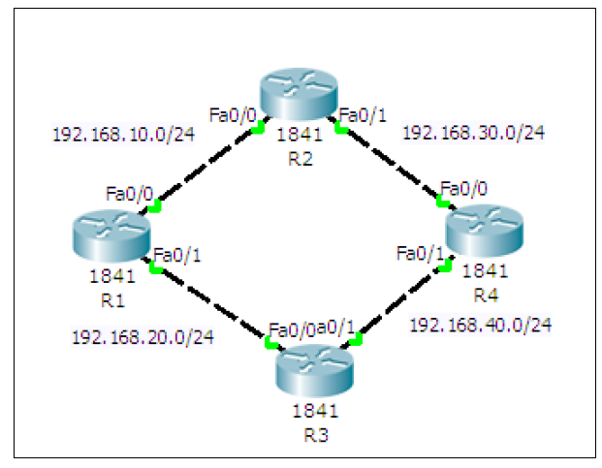
Static Routing Setup
Create a ring topology
(Next slide for details)

Slide 4
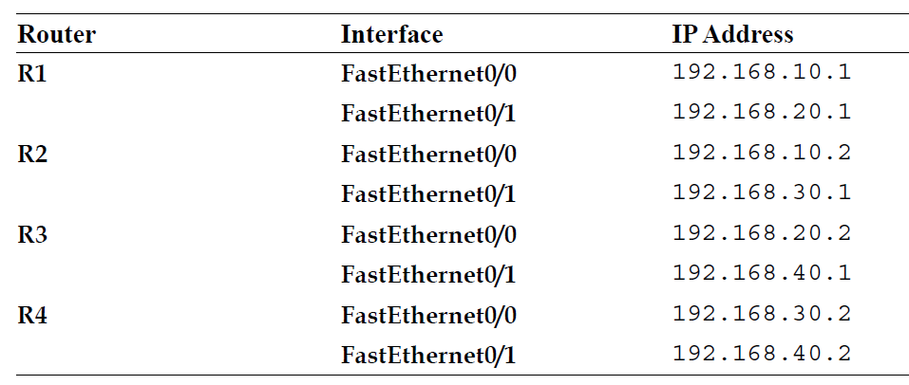
Creating the Ring Topology
Add four routers with the following details – Make sure Port is On

Slide 5
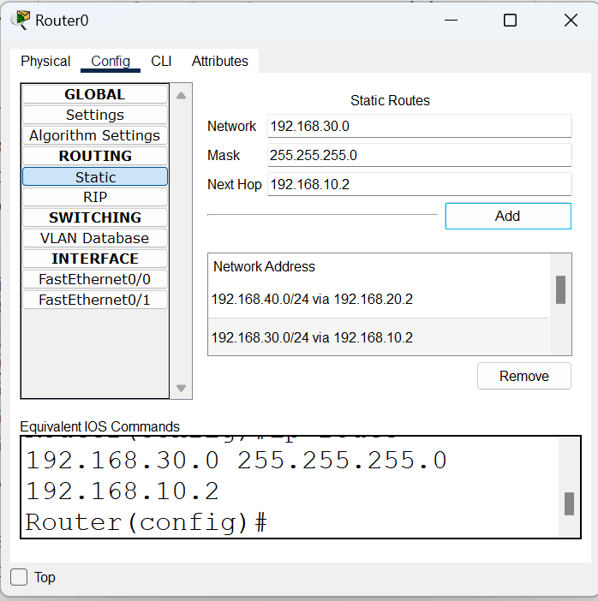
Configuring Routes Statically
Open the first Router (R1) and in Routing, add the routes
Enter the details here and click on Add

Slide 6
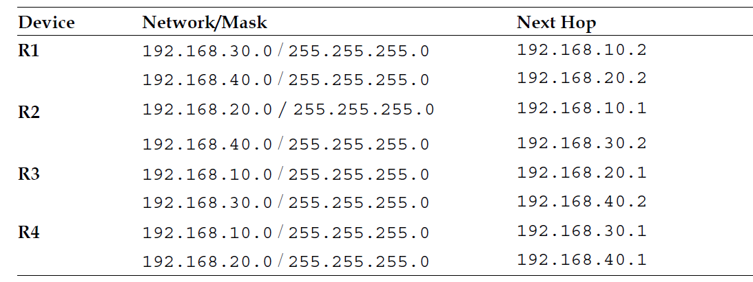
Similarly, for the Others, Add Information as Below

Slide 7

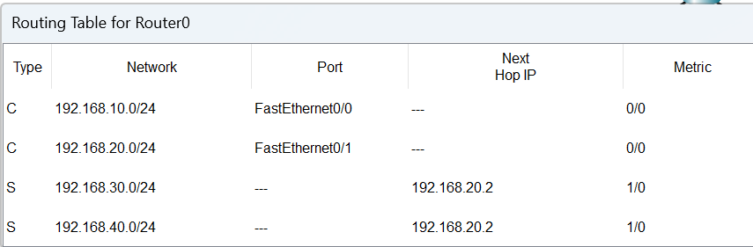
Checking Routing Table
We can examine any router’s routing table by clicking on the search button (called Inspect) on the top left corner of the screen
and then selecting a router

Slide 8
Testing
Add a simple PDU from the menu to any two routers and see if they can route the packet correctly or not

Slide 9
Static Routing Using CLI
Consider four routers:
R1 has IP addresses 192.168.10.1 on interface F0/0 and 192.168.20.1 on interface F0/1
R2 has IP addresses 192.168.10.2 on interface F0/0 and 192.168.30.1 on interface F0/1
R3 has IP addresses 192.168.20.2 on interface F0/0 and 192.168.40.1 on interface F0/1
R4 has IP addresses 192.168.30.2 on interface F0/0 and 192.168.40.2 on interface F0/1
Write Cisco Packet Tracer commands for basic router set up, followed by static routing commands.

Slide 10
Static Routing – R1
R1>enable
R1#configure terminal
R1(config)#hostname R1
R1(config)#interface FastEthernet0/0
R1(config-if)#ip address 192.168.10.1 255.255.255.0
R1(config-if)#no shutdown
R1(config-if)#exit
R1(config)#interface FastEthernet0/1
R1(config-if)#ip address 192.168.20.1 255.255.255.0
R1(config-if)#no shutdown
R1(config-if)#exit
R1(config)#exit
R1>enable
R1#configure terminal
R1(config)#ip route 192.168.30.0 255.255.255.0 192.168.20.2
R1(config)#ip route 192.168.40.0 255.255.255.0 192.168.20.2
R1(config)#exit
Basic router set up
Static routing

Slide 11
Static Routing – R2
R2>enable
R2#configure terminal
R2(config)#hostname R2
R2(config)#interface FastEthernet0/0
R2(config-if)#ip address 192.168.10.2 255.255.255.0
R2(config-if)#no shutdown
R2(config-if)#exit
R2(config)#interface FastEthernet0/1
R2(config-if)#ip address 192.168.30.1 255.255.255.0
R2(config-if)#no shutdown
R2(config-if)#exit
R2(config)#exit
R2>enable
R2#configure terminal
R2(config)#ip route 192.168.20.0 255.255.255.0 192.168.10.1
R2(config)#ip route 192.168.40.0 255.255.255.0 192.168.30.2
R2(config)#exit

Slide 12
Static Routing – R3
R3>enable
R3#configure terminal
R3(config)#hostname R3
R3(config)#interface FastEthernet0/0
R3(config-if)#ip address 192.168.20.2 255.255.255.0
R3(config-if)#no shutdown
R3(config-if)#exit
R3(config)#interface FastEthernet0/1
R3(config-if)#ip address 192.168.40.1 255.255.255.0
R3(config-if)#no shutdown
R3(config-if)#exit
R3(config)#exit
R3>enable
R3#configure terminal
R3(config)#ip route 192.168.10.0 255.255.255.0 192.168.20.1
R3(config)#ip route 192.168.30.0 255.255.255.0 192.168.40.2
R3(config)#exit

Slide 13
Static Routing – R4
R4>enable
R4#configure terminal
R4(config)#hostname R4
R4(config)#interface FastEthernet0/0
R4(config-if)#ip address 192.168.30.2 255.255.255.0
R4(config-if)#no shutdown
R4(config-if)#exit
R4(config)#interface FastEthernet0/1
R4(config-if)#ip address 192.168.40.2 255.255.255.0
R4(config-if)#no shutdown
R4(config-if)#exit
R4(config)#exit
R4>enable
R4#configure terminal
R4(config)#ip route 192.168.10.0 255.255.255.0 192.168.30.1
R4(config)#ip route 192.168.20.0 255.255.255.0 192.168.40.1
R4(config)#exit

Slide 14
How to “undo” a Route?
How to "undo" a route?
Original command
Router(config)# ip route 192.168.2.0 255.255.255.0 10.0.0.1
To cancel/undo the route command
Router(config)# no ip route 192.168.2.0 255.255.255.0 10.0.0.1

Slide 15
How to “undo” an IP address?
How to "undo" an IP address?
Original command
Router(config)# ip address 192.168.20.2 255.255.255.0
To cancel/undo the IP address command
Router(config)# no ip address

Slide 16
Dynamic Routing

Slide 17
Dynamic Routing
Routing Information Protocol (RIP) is used by routers to exchange information so as to build routing tables
We do not have to add routing information statically now
Routers automatically do this

Slide 18
Configuring RIP
1. Create the same four-router topology we used previously and assign the same IP addresses through the Config tab.

Slide 19
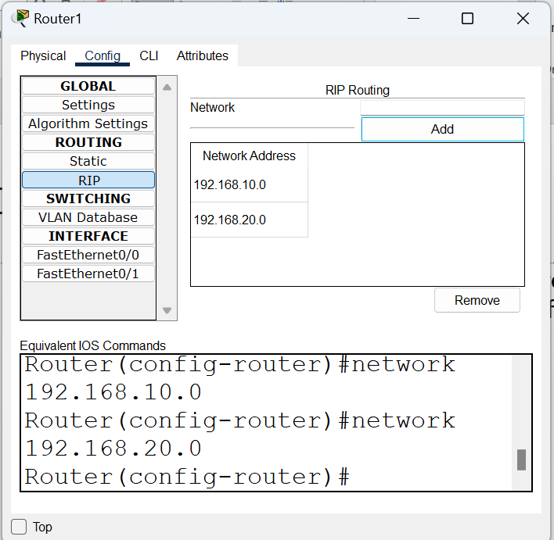
Configuring RIP
2. Click on RIP. This is very easy. Each router now requires only the Network IP of its own interfaces, as shown in the following screenshot:
Full list – next slide

Slide 20
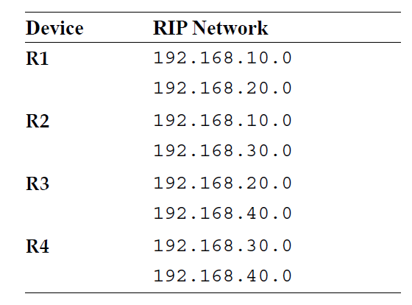
Network Addresses for RIP Configuration

Slide 21
Test using the PDU
Same as before

Slide 22
RIP Dynamic Routing Using CLI
Consider four routers:
R1 has IP addresses 192.168.10.1 on interface F0/0 and 192.168.20.1 on interface F0/1
R2 has IP addresses 192.168.10.2 on interface F0/0 and 192.168.30.1 on interface F0/1
R3 has IP addresses 192.168.20.2 on interface F0/0 and 192.168.40.1 on interface F0/1
R4 has IP addresses 192.168.30.2 on interface F0/0 and 192.168.40.2 on interface F0/1
Write Cisco Packet Tracer commands for basic router set up, followed by static routing commands.

Slide 23
Dynamic Routing using RIP - R1
R1>enable
R1#configure terminal
R1(config)#hostname R1
R1(config)#interface FastEthernet0/0
R1(config-if)#ip address 192.168.10.1 255.255.255.0
R1(config-if)#no shutdown
R1(config-if)#exit
R1(config)#interface FastEthernet0/1
R1(config-if)#ip address 192.168.20.1 255.255.255.0
R1(config-if)#no shutdown
R1(config-if)#exit
R1(config)#exit
R1>enable
R1#configure terminal
R1(config)#router rip
R1(config-router)#version 2
R1(config-router)#network 192.168.10.0
R1(config-router)#network 192.168.20.0
R1(config-router)#exit
R1(config)#exit
Basic router set up
Dynamic routing using RIP

Slide 24
Dynamic Routing using RIP – R2
R2>enable
R2#configure terminal
R2(config)#hostname R2
R2(config)#interface FastEthernet0/0
R2(config-if)#ip address 192.168.10.2 255.255.255.0
R2(config-if)#no shutdown
R2(config-if)#exit
R2(config)#interface FastEthernet0/1
R2(config-if)#ip address 192.168.30.1 255.255.255.0
R2(config-if)#no shutdown
R2(config-if)#exit
R2(config)#exit
R2>enable
R2#configure terminal
R2(config)#router rip
R2(config-router)#version 2
R2(config-router)#network 192.168.10.0
R2(config-router)#network 192.168.30.0
R2(config-router)#exit
R2(config)#exit

Slide 25
Dynamic Routing using RIP – R3
R3>enable
R3#configure terminal
R3(config)#hostname R3
R3(config)#interface FastEthernet0/0
R3(config-if)#ip address 192.168.20.2 255.255.255.0
R3(config-if)#no shutdown
R3(config-if)#exit
R3(config)#interface FastEthernet0/1
R3(config-if)#ip address 192.168.40.1 255.255.255.0
R3(config-if)#no shutdown
R3(config-if)#exit
R3(config)#exit
R3>enable
R3#configure terminal
R3(config)#router rip
R3(config-router)#version 2
R3(config-router)#network 192.168.20.0
R3(config-router)#network 192.168.40.0
R3(config-router)#exit
R3(config)#exit

Slide 26
Dynamic Routing using RIP – R4
R4>enable
R4#configure terminal
R4(config)#hostname R4
R4(config)#interface FastEthernet0/0
R4(config-if)#ip address 192.168.30.2 255.255.255.0
R4(config-if)#no shutdown
R4(config-if)#exit
R4(config)#interface FastEthernet0/1
R4(config-if)#ip address 192.168.40.2 255.255.255.0
R4(config-if)#no shutdown
R4(config-if)#exit
R4(config)#exit
R4>enable
R4#configure terminal
R4(config)#router rip
R4(config-router)#version 2
R4(config-router)#network 192.168.30.0
R4(config-router)#network 192.168.40.0
R4(config-router)#exit
R4(config)#exit

Slide 27
Dynamic Routing using EIGRP

Slide 28
EIGRP Configuration
Consider four routers:
R1 has IP addresses 192.168.10.1 on interface F0/0 and 192.168.20.1 on interface F0/1
R2 has IP addresses 192.168.10.2 on interface F0/0 and 192.168.30.1 on interface F0/1
R3 has IP addresses 192.168.20.2 on interface F0/0 and 192.168.40.1 on interface F0/1
R4 has IP addresses 192.168.30.2 on interface F0/0 and 192.168.40.2 on interface F0/1
Write Cisco Packet Tracer commands for the basic router set up followed by EIGRP commands for each router.

Slide 29
EIGRP on R1
R1>enable
R1#configure terminal
R1(config)#hostname R1
R1(config)#interface FastEthernet0/0
R1(config-if)#ip address 192.168.10.1 255.255.255.0
R1(config-if)#no shutdown
R1(config-if)#exit
R1(config)#interface FastEthernet0/1
R1(config-if)#ip address 192.168.20.1 255.255.255.0
R1(config-if)#no shutdown
R1(config-if)#exit
R1(config)#exit
R1>enable
R1#configure terminal
R1(config)#router eigrp 100
R1(config-router)#network 192.168.10.0
R1(config-router)#network 192.168.20.0
R1(config-router)#exit
R1(config)#exit

Slide 30
EIGRP on R2
R2>enable
R2#configure terminal
R2(config)#hostname R2
R2(config)#interface FastEthernet0/0
R2(config-if)#ip address 192.168.10.2 255.255.255.0
R2(config-if)#no shutdown
R2(config-if)#exit
R2(config)#interface FastEthernet0/1
R2(config-if)#ip address 192.168.30.1 255.255.255.0
R2(config-if)#no shutdown
R2(config-if)#exit
R2(config)#exit
R2>enable
R2#configure terminal
R2(config)#router eigrp 100
R2(config-router)#network 192.168.10.0
R2(config-router)#network 192.168.30.0
R2(config-router)#exit
R2(config)#exit

Slide 31
EIGRP on R3
R3>enable
R3#configure terminal
R3(config)#hostname R3
R3(config)#interface FastEthernet0/0
R3(config-if)#ip address 192.168.20.2 255.255.255.0
R3(config-if)#no shutdown
R3(config-if)#exit
R3(config)#interface FastEthernet0/1
R3(config-if)#ip address 192.168.40.1 255.255.255.0
R3(config-if)#no shutdown
R3(config-if)#exit
R3(config)#exit
R3>enable
R3#configure terminal
R3(config)#router eigrp 100
R3(config-router)#network 192.168.20.0
R3(config-router)#network 192.168.40.0
R3(config-router)#exit
R3(config)#exit

Slide 32
EIGRP on R4
R4>enable
R4#configure terminal
R4(config)#hostname R4
R4(config)#interface FastEthernet0/0
R4(config-if)#ip address 192.168.30.2 255.255.255.0
R4(config-if)#no shutdown
R4(config-if)#exit
R4(config)#interface FastEthernet0/1
R4(config-if)#ip address 192.168.40.2 255.255.255.0
R4(config-if)#no shutdown
R4(config-if)#exit
R4(config)#exit
R4>enable
R4#configure terminal
R4(config)#router eigrp 100
R4(config-router)#network 192.168.30.0
R4(config-router)#network 192.168.40.0
R4(config-router)#exit
R4(config)#exit

Slide 33
Dynamic Routing using OSPF

Slide 34
Dynamic Routing OSPF
Consider four routers:
R1 has IP addresses 192.168.10.1 on interface F0/0 and 192.168.20.1 on interface F0/1
R2 has IP addresses 192.168.10.2 on interface F0/0 and 192.168.30.1 on interface F0/1
R3 has IP addresses 192.168.20.2 on interface F0/0 and 192.168.40.1 on interface F0/1
R4 has IP addresses 192.168.30.2 on interface F0/0 and 192.168.40.2 on interface F0/1
Write Cisco Packet Tracer commands for the basic router set up followed by OSPF commands for each router.

Slide 35
OSPF – R1
R1>enable
R1#configure terminal
R1(config)#hostname R1
R1(config)#interface FastEthernet0/0
R1(config-if)#ip address 192.168.10.1 255.255.255.0
R1(config-if)#no shutdown
R1(config-if)#exit
R1(config)#interface FastEthernet0/1
R1(config-if)#ip address 192.168.20.1 255.255.255.0
R1(config-if)#no shutdown
R1(config-if)#exit
R1(config)#exit
R1>enable
R1#configure terminal
R1(config)#router ospf 1
R1(config-router)#network 192.168.10.0 0.0.0.255 area 0
R1(config-router)#network 192.168.20.0 0.0.0.255 area 0
R1(config-router)#exit
R1(config)#exit

Slide 36
OSPF – R2
R2>enable
R2#configure terminal
R2(config)#hostname R2
R2(config)#interface FastEthernet0/0
R2(config-if)#ip address 192.168.10.2 255.255.255.0
R2(config-if)#no shutdown
R2(config-if)#exit
R2(config)#interface FastEthernet0/1
R2(config-if)#ip address 192.168.30.1 255.255.255.0
R2(config-if)#no shutdown
R2(config-if)#exit
R2(config)#exit
R2>enable
R2#configure terminal
R2(config)#router ospf 1
R2(config-router)#network 192.168.10.0 0.0.0.255 area 0
R2(config-router)#network 192.168.30.0 0.0.0.255 area 0
R2(config-router)#exit
R2(config)#exit

Slide 37
OSPF – R3
R3>enable
R3#configure terminal
R3(config)#hostname R3
R3(config)#interface FastEthernet0/0
R3(config-if)#ip address 192.168.20.2 255.255.255.0
R3(config-if)#no shutdown
R3(config-if)#exit
R3(config)#interface FastEthernet0/1
R3(config-if)#ip address 192.168.40.1 255.255.255.0
R3(config-if)#no shutdown
R3(config-if)#exit
R3(config)#exit
R3>enable
R3#configure terminal
R3(config)#router ospf 1
R3(config-router)#network 192.168.20.0 0.0.0.255 area 0
R3(config-router)#network 192.168.40.0 0.0.0.255 area 0
R3(config-router)#exit
R3(config)#exit

Slide 38
OSPF – R4
R4>enable
R4#configure terminal
R4(config)#hostname R4
R4(config)#interface FastEthernet0/0
R4(config-if)#ip address 192.168.30.2 255.255.255.0
R4(config-if)#no shutdown
R4(config-if)#exit
R4(config)#interface FastEthernet0/1
R4(config-if)#ip address 192.168.40.2 255.255.255.0
R4(config-if)#no shutdown
R4(config-if)#exit
R4(config)#exit
R4>enable
R4#configure terminal
R4(config)#router ospf 1
R4(config-router)#network 192.168.30.0 0.0.0.255 area 0
R4(config-router)#network 192.168.40.0 0.0.0.255 area 0
R4(config-router)#exit
R4(config)#exit

